Slide 1
Topics in Cybersecurity
Javascript (DOM manipulation)

Slide 2
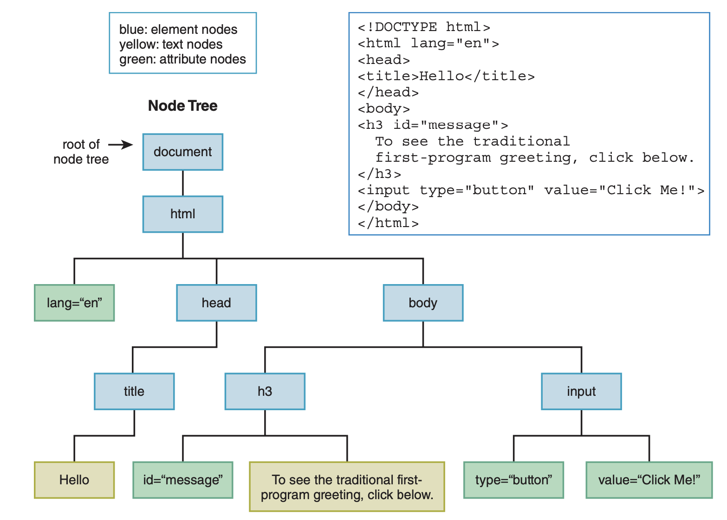
Document Object Model
The Document Object Model (DOM) models all of the parts of a web page document as nodes in a node tree.
A node tree is similar to a directory tree, it shows web page elements that include other elements (and text and attributes).
Each node represents either
an element,
a text item that appears between an element’s start and end tags, or
an attribute within one of the elements.

Slide 3
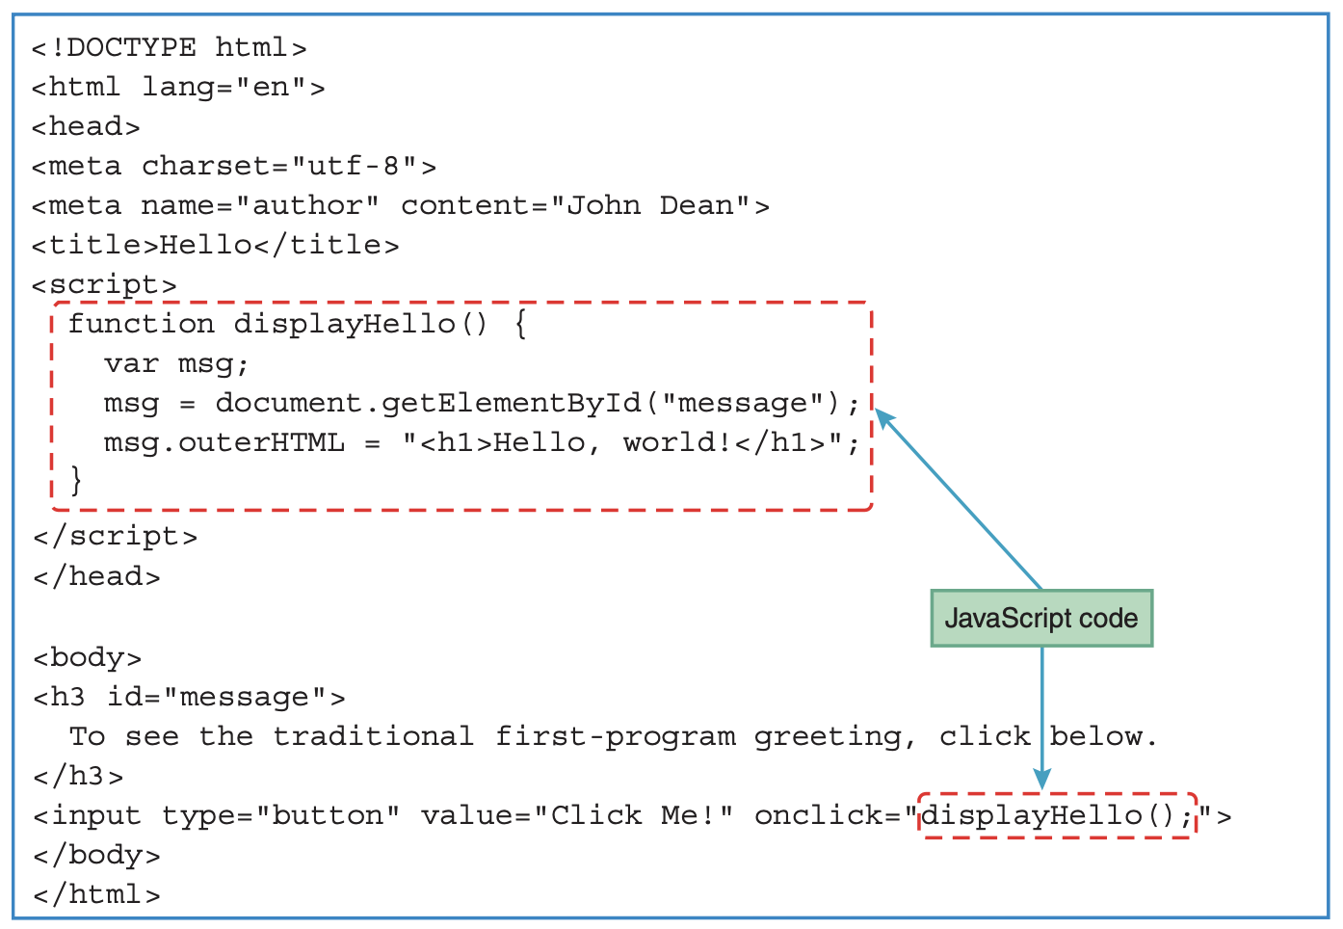
Hello World

Slide 4
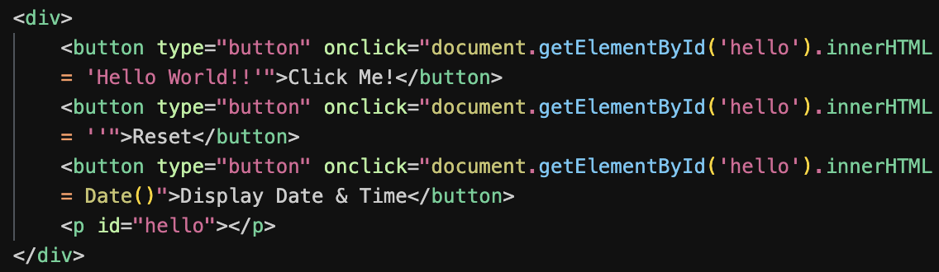
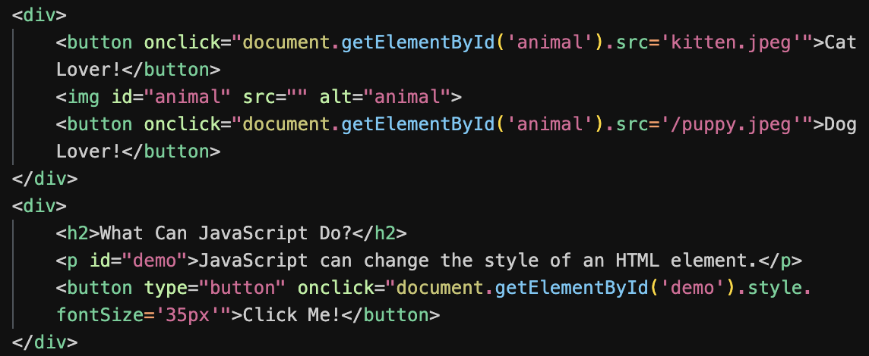
Changing HTML content

Slide 5
Hello World
The input element’s onclick attribute specifies the JavaScript instructions that the JavaScript engine executes when the user clicks the button.
A JavaScript engine is the part of the browser software that runs a web page’s JavaScript.
The onclick attribute’s value is JavaScript code that “handles” what’s supposed to happen when the user clicks the button.
Clicking the button is considered to be an event, so the onclick attribute’s JavaScript code is known as an event handler.
Besides onclick, there are other attributes that call event handlers, like onfocus and onload.
onclick attribute’s value is displayHello(); that calls the displayHello function, which is defined in the web page’s script block.

Slide 6
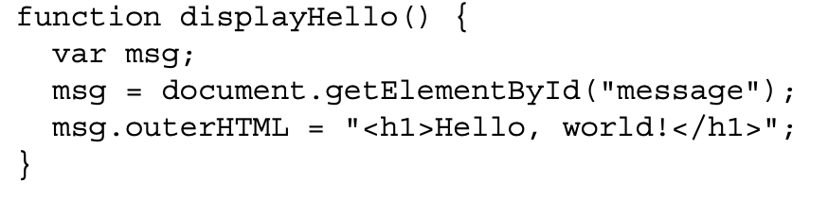
Objects and their properties
getElementById method retrieves the object associated with the h3 element.
After msg gets the h3 element’s object, that object gets updated with this assignment statement:
msg.outerHTML = "<h1>Hello, world!</h1>";
All element objects have an outerHTML property, which stores the element’s code, including the element’s start and end tags.
Assigning<h1>Hello, world!</h1> to msg.outerHTML causes msg’s code to be replaced with <h1>Hello, world!</h1>.
the h3 start and end tags get replaced with h1 start and end tags.
an innerHTML property accesses the content that’s between the element’s start and end tags, and it does not include the element’s start and end tags.
Notes:
Onfocus: Element receives focus, usually by clicking into it or using the Tab key

Slide 7
Document Object Model
The term dynamic HTML refers to updating the web page’s content by manipulating the DOM’s nodes.
The DOM provides different ways to access the nodes in the node tree. Here are three common techniques:
You can retrieve the node tree’s root by using document (for the document object) in your code and then use the root object as a starting point in traversing down the tree.
You can retrieve the node that the user just interacted with (e.g. a button that was clicked) and use that node object as a starting point in traversing up or down the tree.
You can retrieve a particular element node by calling the document object’s getElementById method with the element’s id value as an argument.

Slide 8
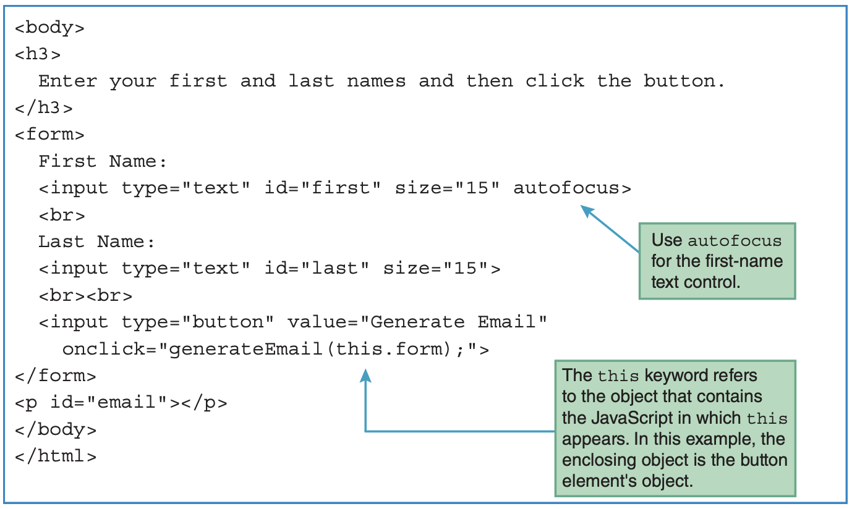
form Element
Notes:
The enclosing object is the button element’s object. The button element’s object has a form property that holds the form that surrounds the button. Therefore, we can pass the form object to the generateEmail function by calling generateEmail(this.form).

Slide 9
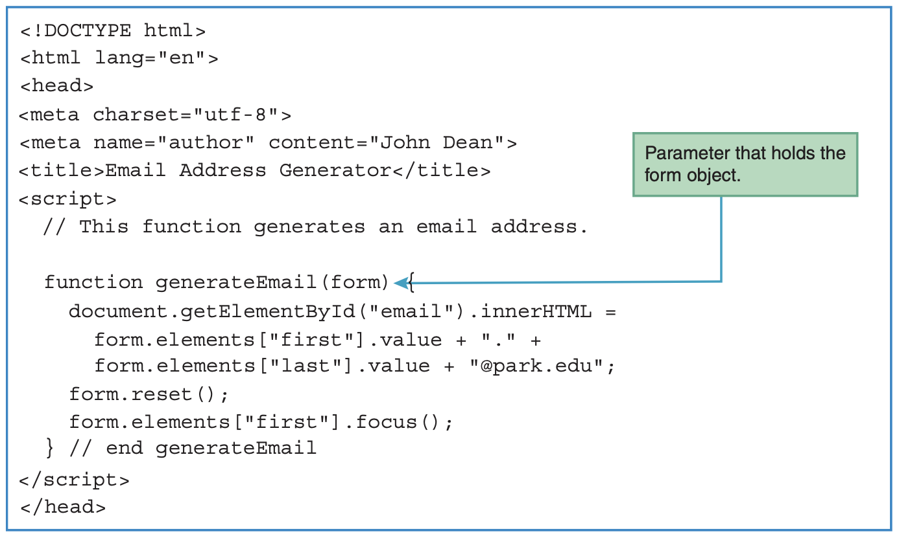
Accessing a Form’s Control Values
Notes:
To access the controls that are within a form, we use the form object’s elements property. The elements property holds a collection of controls, where a collection is a group of items that are of the same type. To access a control within the elements collection, you put quotes around the control’s id value and surround the quoted value with []’s.

Slide 10
Javascript Form Validation
Form validation is a critical aspect of web development, ensuring that the data users submit is complete, accurate, and formatted properly before it reaches the server.
JavaScript plays a key role in client-side form validation, enhancing user experience by providing real-time feedback and reducing server load.

Slide 11
Javascript Form Validation
JavaScript form validation involves using scripts in the browser to check input fields in a form for:
Correctness (e.g., valid email format).
Completeness (e.g., required fields are filled).
Logical consistency (e.g., password confirmation matches password).

Slide 12
benefits
Real-time feedback: Users can see errors instantly.
Reduced server load: Invalid data is caught before being sent.
Enhanced user experience: Forms become interactive and intuitive.

Slide 13
Regular Expressions in form validation
Regular Expressions (regex) are powerful patterns used to match and validate string data.
In JavaScript, they are used extensively for validating input fields like email addresses, phone numbers, and more.
const regex = pattern/flags;

Slide 14
Regular Expressions in form validation
Examples of common regex patterns:
Email validation: /^[^\s@]+@[^\s@]+\.[^\s@]+$/
^ – Start of the string.
[^\s@]+ One or more characters that are not whitespace (\s) or @.
@ Literal @ symbol.
\. A literal dot (.) character (escaped) since “.” is a regex metacharacter meaning "any character"
$ End of the string.

Slide 15
Regular Expressions in form validation
Phone number validation: /^\d{10}$/
Password (minimum 8 characters, with letters and numbers):
/^(?=.*[A-Za-z])(?=.*\d)[A-Za-z\d]{8,}$/
Notes:
?= means any character ahead
. Means any character
Means zero or more times
[] — Character Set (Character Class)
() — Grouping & Capturing
(abc) → matches the exact string 'abc'
(a|b)c → matches 'ac' or 'bc'
(ab){3} → matches 'ababab’
{} — Quantifiers
a{3} → matches 'aaa'
\d{2,4} → matches 2 to 4 digits
a{1,} → at least one ’a. always use lower bound in javascript

Slide 16
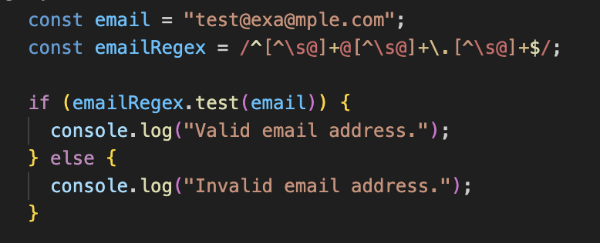
example
The method test returns a boolean value that indicates whether or not a pattern exists in a searched string

Slide 17
Client side validation approaches
There are two main approaches to client side validation:
HTML 5 built in validation
Custom validation with javascript

Slide 18
Html 5 built-in validation
Uses attributes like required, minlength, maxlength, pattern, and type.
<input type="email" required />

Slide 19
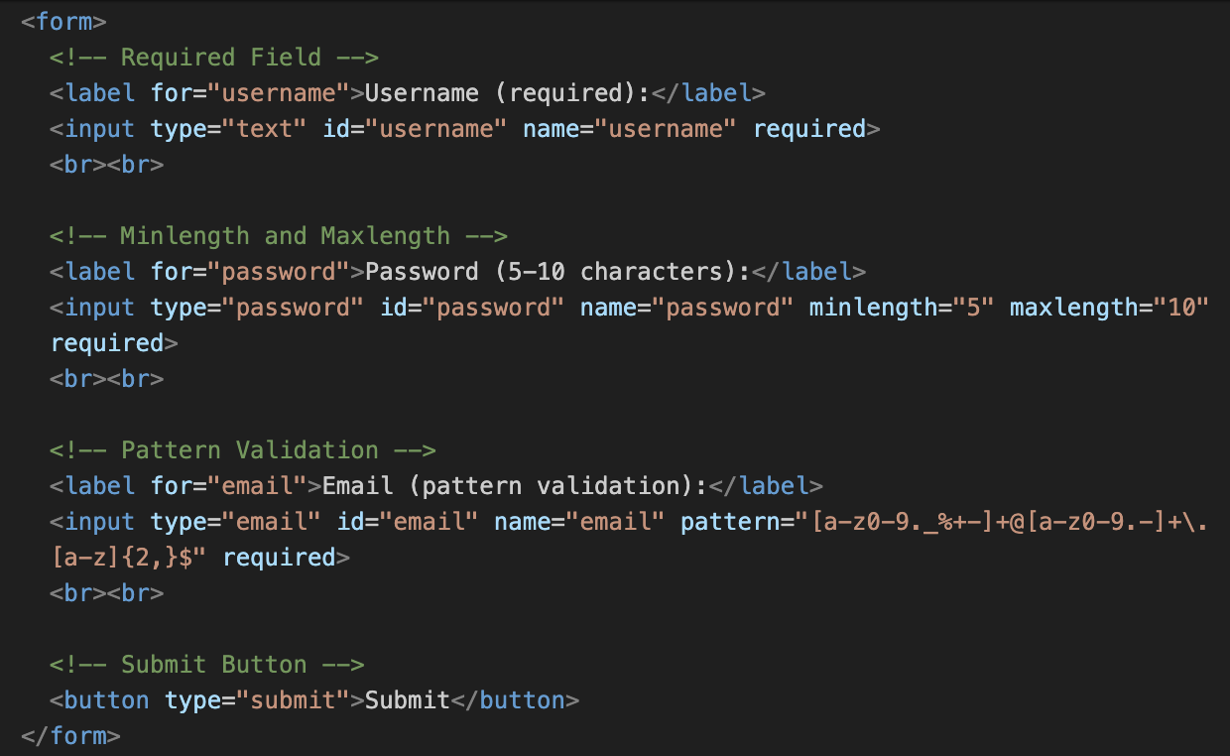
Notes:
pattern: Enforces a specific format using a regular expression. In this example:[a-z0-9._%+-]+ ensures the local part of the email includes valid characters.
@[a-z0-9.-]+ matches the domain part.
\.[a-z]{2,}$ ensures a valid top-level domain (e.g., .com, .org).

Slide 20
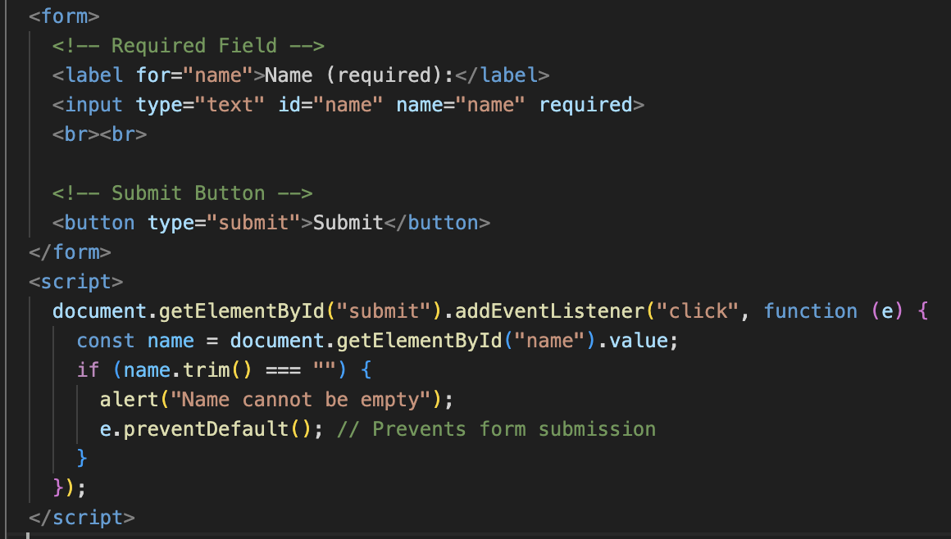
Custom validation using javascript
Allows more control and flexibility compared to HTML 5.

Slide 21
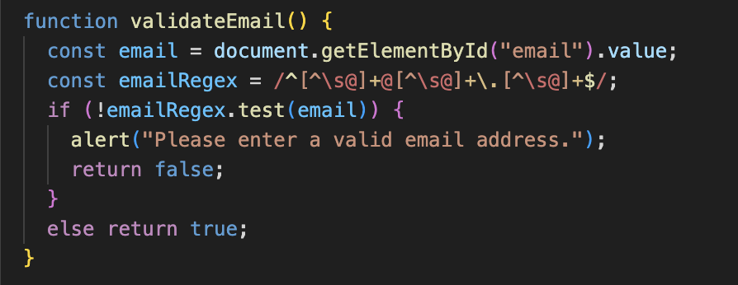

Slide 22
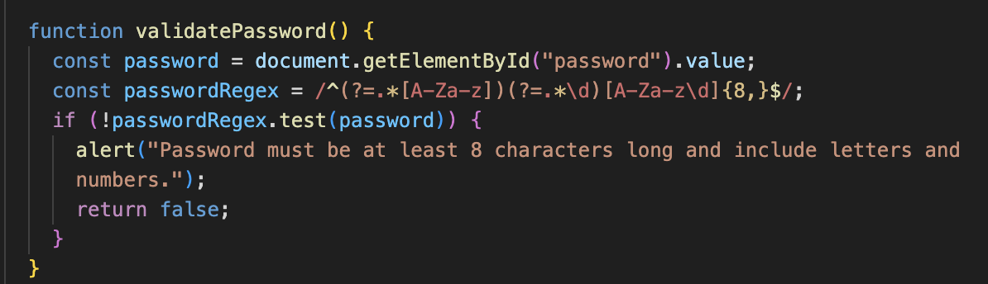

Slide 23
Best Practices
Combine Client-side and Server-side Validation: Client-side validation enhances user experience, but server-side validation is crucial for security.
Use Clear Error Messages: Help users understand and correct mistakes easily.
Validate on Form Submit and On-the-Fly: Validate as users type and again before submission.
Prevent Default Actions: Use event.preventDefault() to stop form submission until all validations pass

